Slide 1
Python Integration with Hadoop MapReduce and Spark

Slide 2
Learning Objectives
By the end of this lesson, you will be able to:
Explain why Python should be integrated with Hadoop
Outline the ecosystem and architecture of Hadoop
Write Python programs for Hadoop operations
Discuss Apache Spark functions and their benefits
Explain the functioning of MapReduce

Slide 3
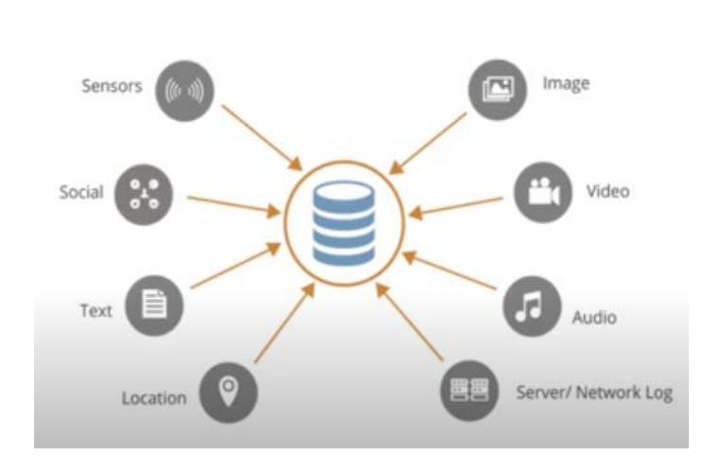
REVIEW
We have seen how big data is generated and understood that to extract insights, proper
analysis of data is more important than its size.

Slide 4
Quick Recap: Why Python
Data Scientists all over the world prefer Python because it is an easy-to-use language that has diverse
libraries required for analytics.

Slide 5
Disparity in Programming Languages
However, Big Data can only be accessed through Hadoop which is completely developed and implemented in Java. Also, analytics platforms are coded in different programming languages.

Slide 6
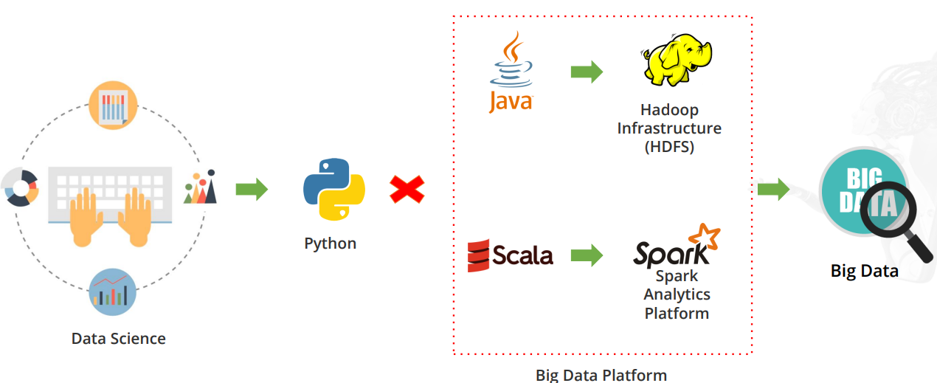

Slide 7
Integrating Python with Hadoop
As Python is a Data Scientist’s first language of choice, both Hadoop and Spark provide Python APIs that allow easy access to the Big Data platform.

Slide 8
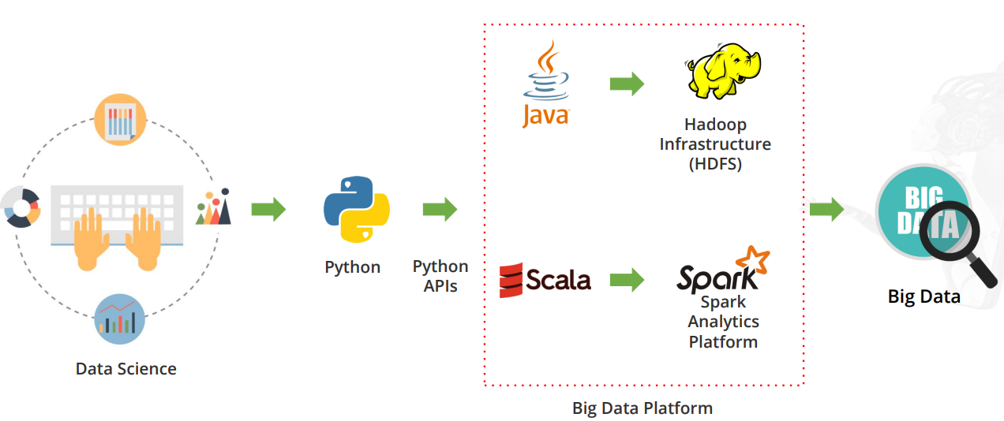

Slide 9
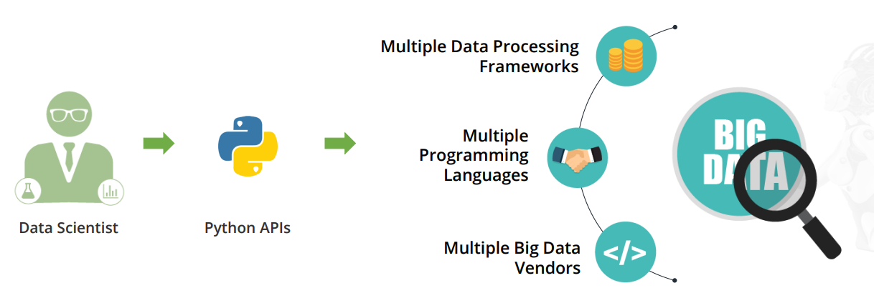
Need for Big Data Solutions in Python
There are several reasons for creating Big Data solutions in Python.

Slide 10
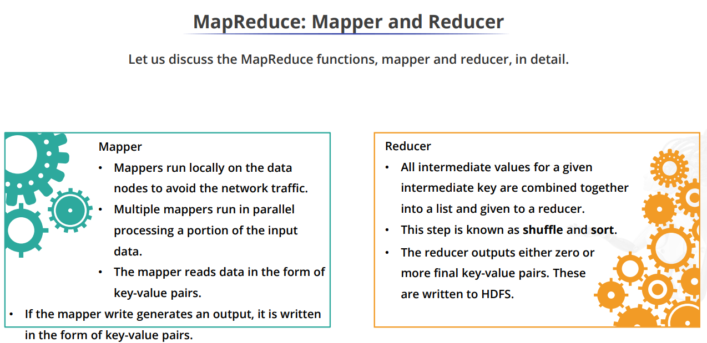
MapReduce: Mapper and Reducer

Slide 11
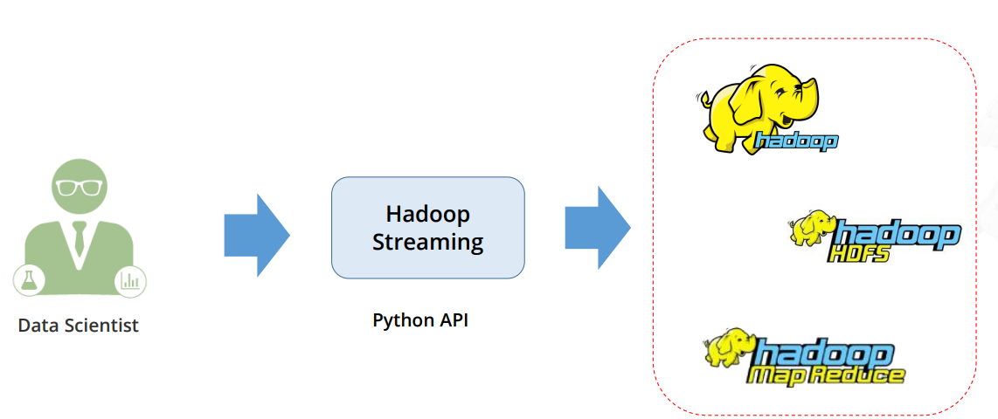
Hadoop Streaming: Python API for Hadoop
Hadoop Streaming acts like a bridge between your Python code and the Java-based HDFS, and lets you seamlessly access Hadoop clusters and execute MapReduce tasks.

Slide 12
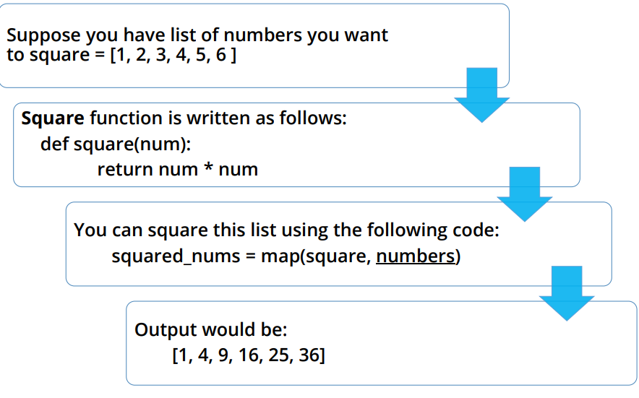
Mapper in Python

Slide 13
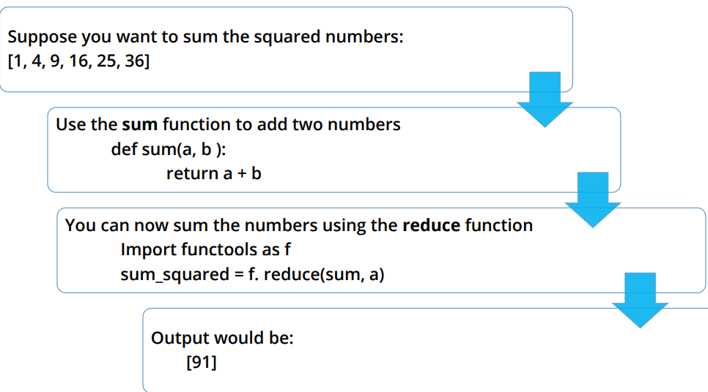
Reducer in Python

Slide 14
Setting Up Cloudera QuickStart Virtual Machine
Cloudera provides enterprise-ready Hadoop Big Data platform which supports Python as well. To set up the Cloudera Hadoop environment, visit the Cloudera link:
http://www.cloudera.com/downloads/quickstart_vms/5-7.html

Slide 15
Apache Spark Resilient Distributed Systems (RDD)
Some basic concepts about Resilient Distributed Datasets (RDD) are:
If the available memory is insufficient, then the data is written to disk.
The main programming approach of Spark is RDD.
They are fault-tolerant collections of objects spread across a cluster that you can
operate on in parallel. They can automatically recover from machine failure.
You can create an RDD either by copying the elements from an existing collection or by referencing a dataset stored externally.
RDDs support two types of operations: transformations and actions.
Transformations use an existing dataset to create a new one. Example: Map, filter, join
Actions compute on the dataset and return the value to the driver program. Example: Reduce, count, collect, save

Slide 16
Advantages of Spark
Faster: 10 to 100 times faster than Hadoop MapReduce
• Simple data processing framework
• Interactive APIs for Python for faster application development
Simplified:
Efficient: Has multiple tools for complex analytics operations
Can be easily integrated with existing Hadoop
infrastructure
Integrated:

Slide 17
Cloudera QuickStart VM: Prerequisites

